Slide 1
LEAD SCORE CASE STUDY
AUTHORS: Deepjyoti Dhar ,Deepriya and Deepak
DS C54 Batch March 2023
IIIT Bangalore
Learning Partner UPGRAD

Slide 2




PROBLEM STATEMENT
INTRODUCTION:
An education company, X Education sells online courses to industry professionals. The company markets its courses on various websites and search engines such as Google
Once people land on the website, they might browse the courses or fill up a form for the course or watch some videos. When these people fill up a form providing their email address or phone number, they are classified to be a lead. Moreover, the company also gets leads through past referrals
Once these leads are acquired, employees from the sales team start making calls, writing emails, etc. The typical lead conversion rate at X education is around 30%
BUSINESS GOALS:
Company wishes to identify the most potential leads, also known as “Hot Leads”
The company needs a model wherein a lead score is assigned to each of the leads such that the customer with higher lead score have a higher conversion chance and customer with lower lead score have a lower conversion chance
The CEO, in particular, has given a ballpark number for the lead conversion rate i.e. 80%

Slide 3




OVERALL APPROACH
DATA CLEANING AND IMPUTING MISSING VALUES
EXPLORATORY DATA ANALYSIS : UNIVARIATE , BIVARIATE and MULTIVARIATE ANALYSIS
FEATURE SCALING AND DUMMY VARIABLE CREATION
LOGISTIC REGRESSION MODEL BUILDING
MODEL EVALUATION : SPECIFICITY , SENSITIVITY, PRECISION and RECALL
CONCLUSION AND RECOMMENDATION

Slide 4




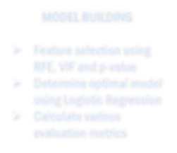



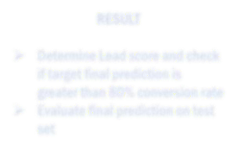
PROBLEM SOLVING METHODOLOGY
DATA CLEANING AND PREPARATION
SPLITTING THE DATA AND FEATURE SCALING
MODEL BUILDING
Read data from source
Convert data into clean format
suitable for analysis
Remove duplicate data
Outlier treatment
Exploratory data analysis
selection using RFE, VIF and p-value
Determine optimal Feature model
using Logistic Regression
Calculate various evaluation metrics
Splitting the data into to
train and test dataset
Feature scaling of numerical variables
RESULT
Determine Lead score and check if target final prediction is greater than 80% conversion rate
Evaluate final prediction on test set

Slide 5





DATA CONVERSION
CONVERTING THE VARIABLE WITH VALUES YES/NO to 1/0s
CONVERTING THE ‘SELECT’ VALUES WITH NaNs
DROPPING THE COLUMNS HAVING >70% OF NULL VALUES
DROPPING UNNECESSARY COLUMNS
DROPPING THE ROWS AS THE NULL VALUES WERE <2%

Slide 6


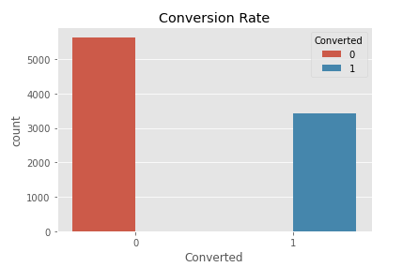
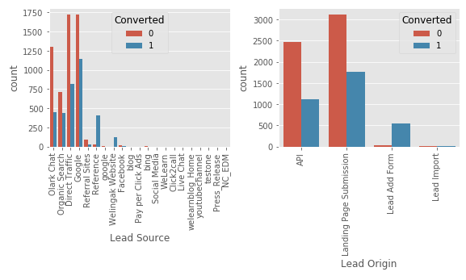




EXPLORATORY DATA ANALYSIS
The count of leads from the Google and Direct Traffic is maximum
The conversion rate of the leads from Reference and Welingkar Website is maximum
API and Landing Page Submission has less conversion rate(~30%) but counts of the leads from them are considerable
The count of leads from the Lead Add Form is pretty low but the conversion rate is very high
We have around 30% of Conversion Rate

Slide 7


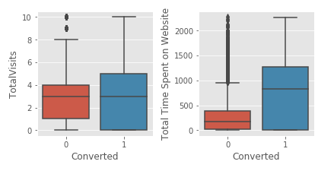
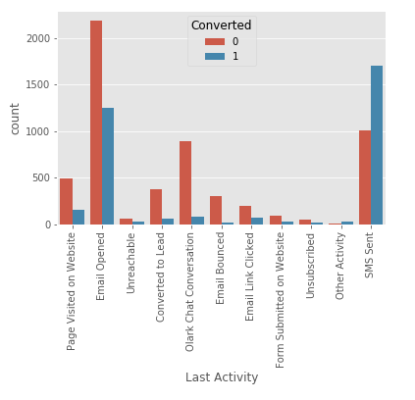




EXPLORATORY DATA ANALYSIS
The median of both the conversion and non-conversion are same and hence nothing conclusive can be said using this information
The count of lead’s last activity as "Email Opened" is maximum
Users spending more time on the website are more likely to get converted
The conversion rate of SMS sent as last activity is maximum

Slide 8

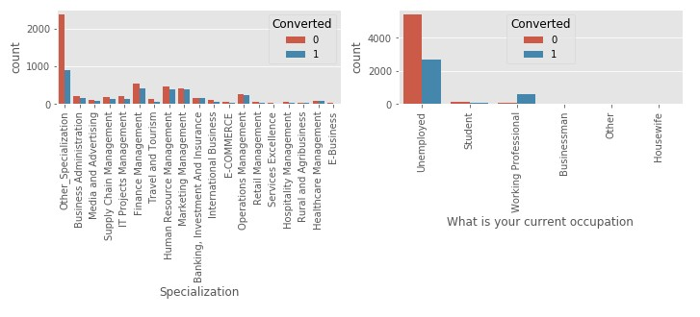


EXPLORATORY DATA ANALYSIS
Looking at above plot, no particular inference can be made for Specialization
Looking at above plot, we can say that working professionals have high conversion rate
'Will revert after reading the email' and 'Closed by Horizon' has high conversion rate
Number of Unemployed leads are more than any other category

Slide 9




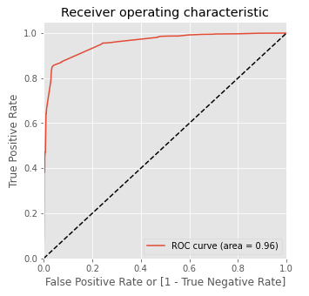
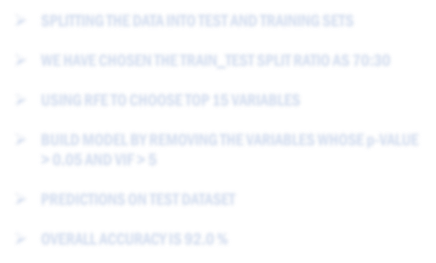



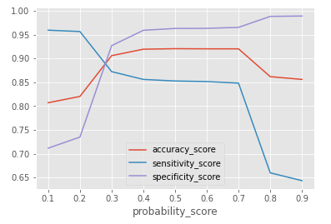
MODEL BUILDING
ROC CURVE
SPLITTING THE DATA INTO TEST AND TRAINING SETS
WE HAVE CHOSEN THE TRAIN_TEST SPLIT RATIO AS 70:30
USING RFE TO CHOOSE TOP 15 VARIABLES
BUILD MODEL BY REMOVING THE VARIABLES WHOSE p-VALUE
> 0.05 AND VIF > 5
ON
OPTIMAL CUT-OFF
OVERALL ACCURACY IS 92.0 %

Slide 10

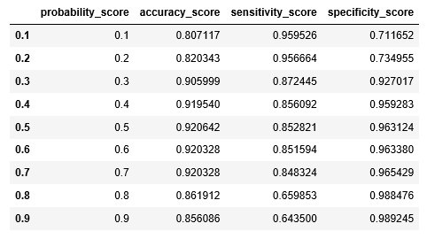




MODEL EVALUATION
CALCULATED ACCURACY, SENSITIVITY AND SPECIFICITY FOR
VARIOUS PROBABILITY CUTOFFS FROM 0.1 TO 0.9
AS PER THE GRAPH AND LOOKING AT THE OTHER SCORES, IT CAN BE SEEN THAT THE OPTIMAL POINT IS 0.27
TRAIN DATA - CONFUSION MATRIX
ACCURACY | 83.59%
PRECISION | 71.6%
SENSITIVITY | 94.9%
SPECIFICITY | 76.5%
PREDICTED ACTUAL | NOT CONVERTED | CONVERTED
NOT CONVERTED | 2987 | 918
CONVERTED | 124 | 2322

Slide 11



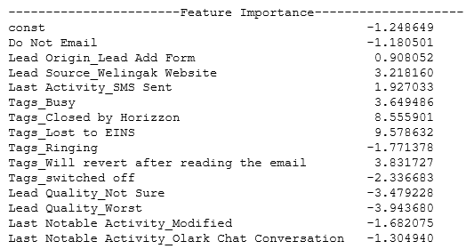

MODEL PREDICTION
TOP FEATURES
TEST DATA - CONFUSION MATRIX
ACCURACY | 81.5%
PRECISION | 68.0%
SENSITIVITY | 92.8%
SPECIFICITY | 75.1%
PREDICTED ACTUAL | NOT CONVERTED | CONVERTED
NOT CONVERTED | 1303 | 431
CONVERTED | 71 | 918

Slide 12



CONCLUSION
The logistic regression model is used to predict the probabilIty of conversion of a customer.
While we have calculated both sensitivity-specificity as well as Precision-Recall metrics, we have considered optimal cut off on the basis of sensitivity-specificity for final prediction
Lead Score calculated shows the conversion rate of final predicted model is around 92% in test data as compared to 95% in train data In Business terms, this model has capability to adjust with the company’s requirements in coming future
TOP variables that contributes for lead getting converted in the model are:
Tags_Lost to EINS
Tags_Closed by Horizon
Lead Quality_Worst
Hence Overall this model seems to be good

